Slide 1
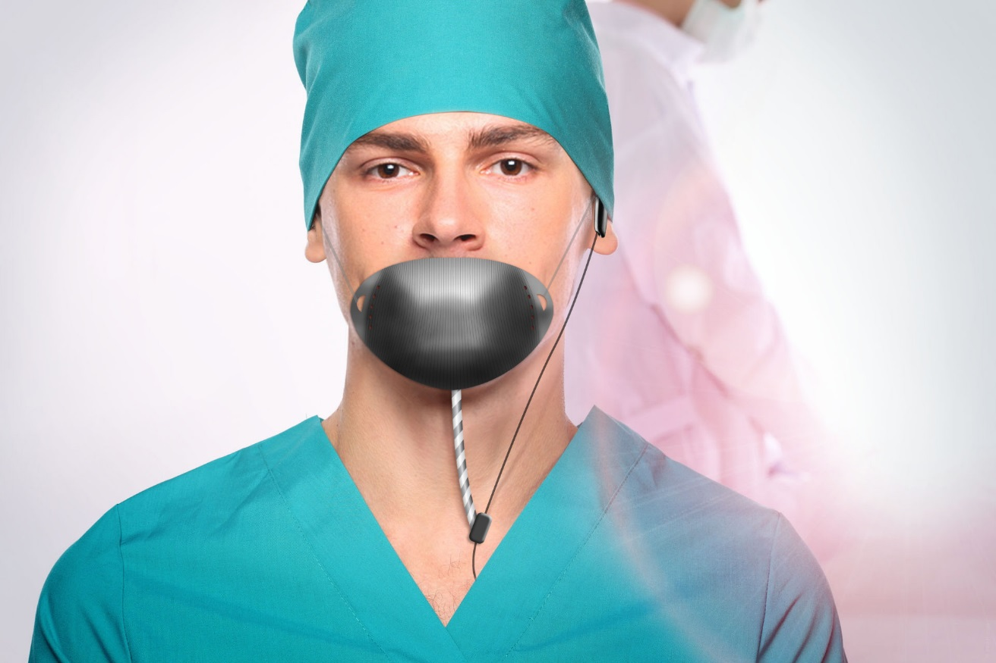

WOXX Inc.
DEVICE for safe AI
Communications
By
Nicolas Casati, Bruno Barbet & François Casati woxxinc.com

Slide 2
WOXX LLC MISSION
Woxx LLC is in the business of providing, producing, and distributing sound direction devices

Slide 3
CURRENT TECHNOLOGIES
- VOICE COMMUNICATION WITH ELECTRONIC EQUIPMENTS
- AI (ARTIFICIAL INTELLIGENCE)
- GENERAL USE OF COMMUNICATION DEVICES IN PUBLIC SPACE
- WIFI IN AIR PLANES (Allowing phone usage)
- LIVE TRANSLATION
- VOICE RECOGNITION
- VOICE CLONING
- NOISE CONTROL (DISTURBANCE)
- AVOIDANCE OF MICROBIAL CONTAMINATION (PANDEMIC)

Slide 4
AI and MARKET NEEDS
- SAFE VOICE COMMUNICATION USING ALL TYPES OF ELECTRONIC EQUIPMENTS ( Cell-phone, computer, personal assistant, etc )
- CONFIDENTIALITY FOR THE SPEAKER WHEN IN PUBLIC SPACES
- NO RISK OF VOICE CLONING BY OUTSIDE CAPTURE
- NO OUTSIDE NOISE DISTURBANCE
- NO RISK OF MICROBE CONTAMINATION ( both from outside and to the surrounding coming from the potentially infected speaker’s breath)
- LOW COST DEVICE with VERSATILiTY of USE
- SIMPLE USE (no need for sophisticated electronics)

Slide 5
ACOUSTICAL TUBE
- Acoustical tube is a simple and safe way to convey voice from the speaker’s mouth to the microphone of an electronic instrument, such as cell-phone, computer, personal assistant, etc.
- Acoustical tube avoids voice sound to be spread to the environment.

Slide 6
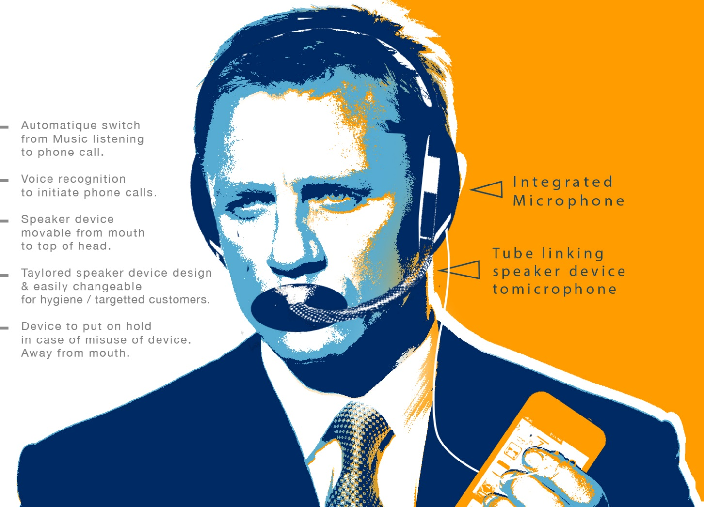
WOXX Inc.
Team
Patents
Marketing Plan
Everyday Situations
S.W.O.T. Analysis

Slide 7
Team
Nicolas Casati, Bruno Barbet & François Casati
woxxinc.com
We are a team of Consultants with extensive Industrial experience in Healthcare, Marketing & R&D
We own two granted US patents :
US 11,778,357 B2 and
Application US 2022/0051791 A1.

Slide 8
Increasing Application usage of human voice
  Mobile phones & Head Phones in Public and in Open Offices
  Voice Recognition usage for ease & speed in Communication Interface
  Use of AI (artificial Intelligence) for multiple purposes
  Increasing Spending in Expensive R&D for Sound Dampening to reduce external interference.
New Health Requirement
  ASIA has been using Face Masks to Protect against Virus & in Particular Influenza
  COVID Protection has led Governments worldwide to Impose Face Masks in Closed Offices & Public Places as well as selectively in Open Places

Slide 9
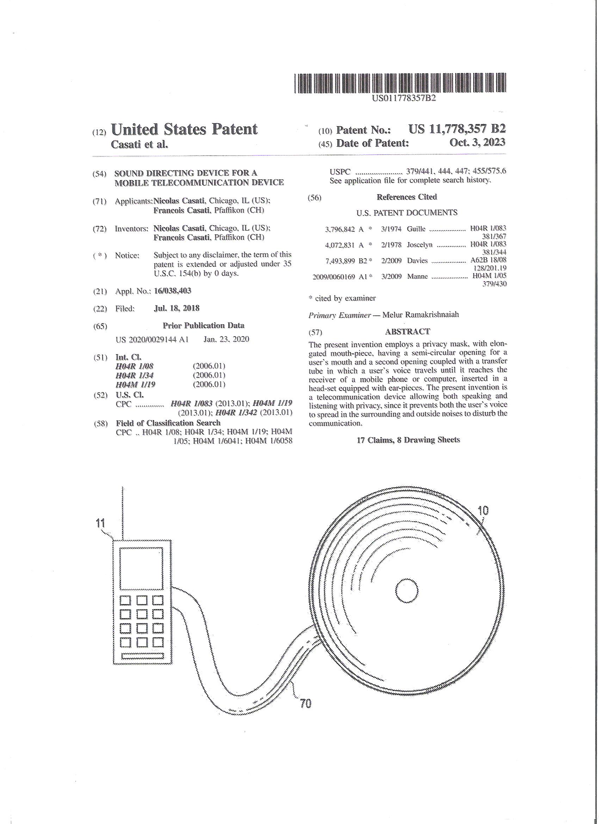
Patents
US 11,778, 357 B2 (October 3, 2023)
SOUND DIRECTING DEVICE FOR A MOBILE TELECOMMUNICATION DEVICE :
Privacy mask
Elongated semi-circular opening for a user’s mouth
Second opening coupled with a transfer tube in which a user’s voice travels until it reaches the receiver of a mobile phone or computer.
The device allowing speaking with privacy
The present device protects the surrounding from saliva projected by the user while speaking loudly

Slide 10
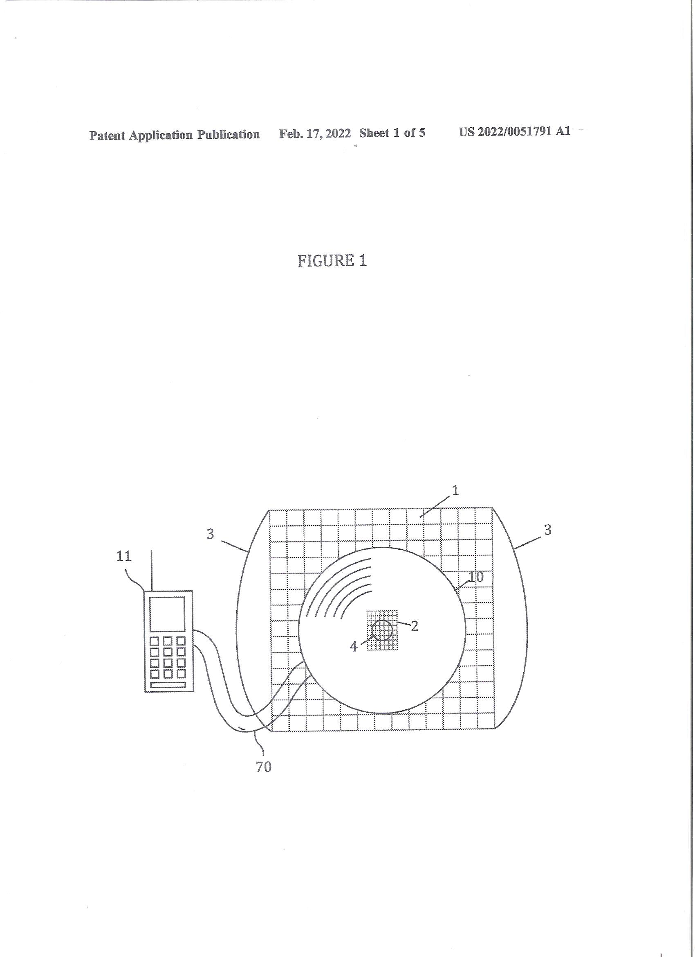
Patents
This Intellectual Property concerns a device which addresses & resolves
  Conversation privacy as well as Voice Disturbance / interference (stress potentially leading to cardio-vascular diseases) of people speaking in a public place whether confined like public transportation such as trains, planes or open spaces such as open offices, streets, restaurants

Slide 11
Patents
Protection against microbe (bacteria, virus) projection
This invention is strengthened by a second granted US Patent
US 2022/0051791 A1 : new surgical mask

Slide 12
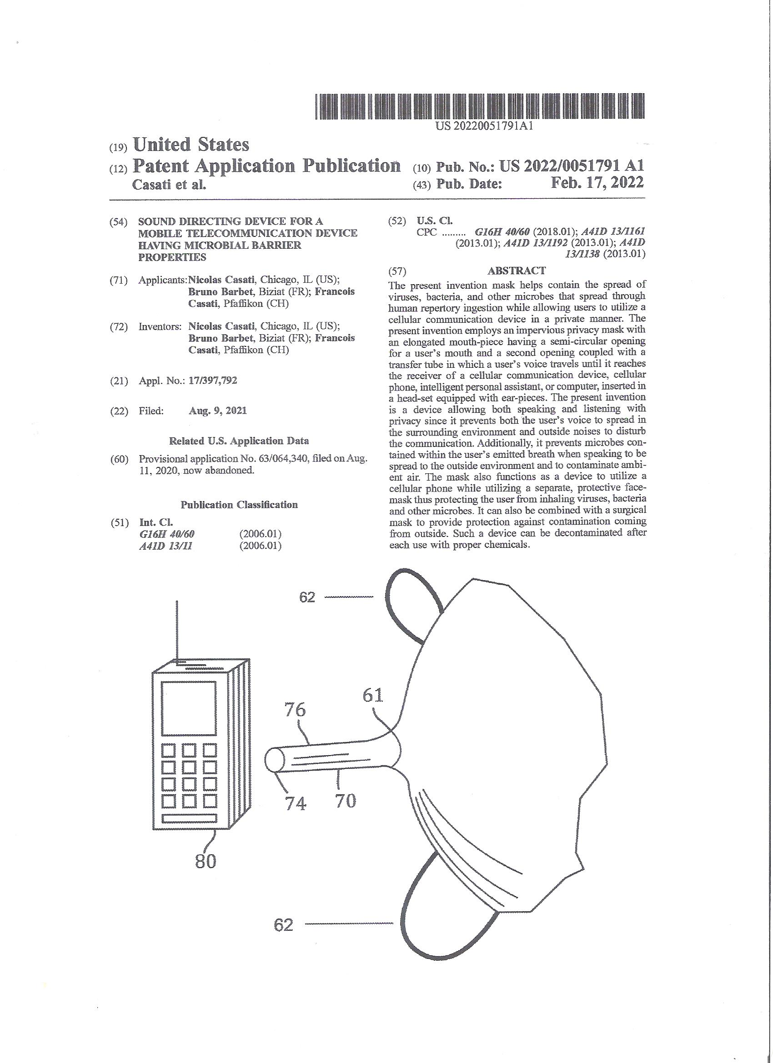
Patents
US 2022/0051791 A1: Sound directing device for a mobile telecommunication device having microbial barrier properties

Slide 13
Patent
The speaker device is lined with a specially designed sound dampening material
Contain voice inside the facial speaker device, avoiding external disturbance + enabling privacy of conversation.
The whole device act as barrier to avoid saliva projection to the surrounding while user speaks loudly in confined environments.
The present Invention incorporates a speaker device with an opening for a user’s mouth & surrounding facial portion
A second opening coupled with a transfer tube in which a user’s voice travels until it reaches the receiver of a mobile phone, computer, microphone, telephone, or similar devices.

Slide 14
Patent
Technology Elements
Speaker device designed for
  Sound transmission
  Breathing
Tube size & length
Tube linking to receiver
Sound absorption material
Barrier for germs (aerosol)

Slide 15
Patent
Partially Resolved : « Freeway »Systems
    background noise eliminated - sophisticated noise dampening softwares
    No spreading of germs in confined environments
  Privacy & External Interference of the person talking
  External interference of wind on microphone

Slide 16
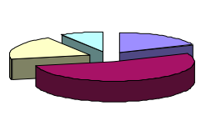
Marketing Plan
Novelty in Head Phone Communications
New Technology Sector Addressing Head Phone Communication Issues
Positively impacting all sectors where head phones & computer verbal communications is/can/could be used
Simple process enhancing/broadening High tech communication solutions sectors
Brings large opportunities of differentiation to designers of communication devices
Open new fields of applications applicable Indoor & Outdoor, Professional & Recreational
Patent protected

Slide 17
Marketing Plan
Commercial attributes
light
comfortable
low cost
disposable elements
opportunity for extensive outer marketing decoration
Conversation privacy
No external interference
  critical in close environment – office, transport.
  Outer noise , wind …
Incorporation in seats – airlines, office ..
AVOID SPREADING OF GERMS

Slide 18
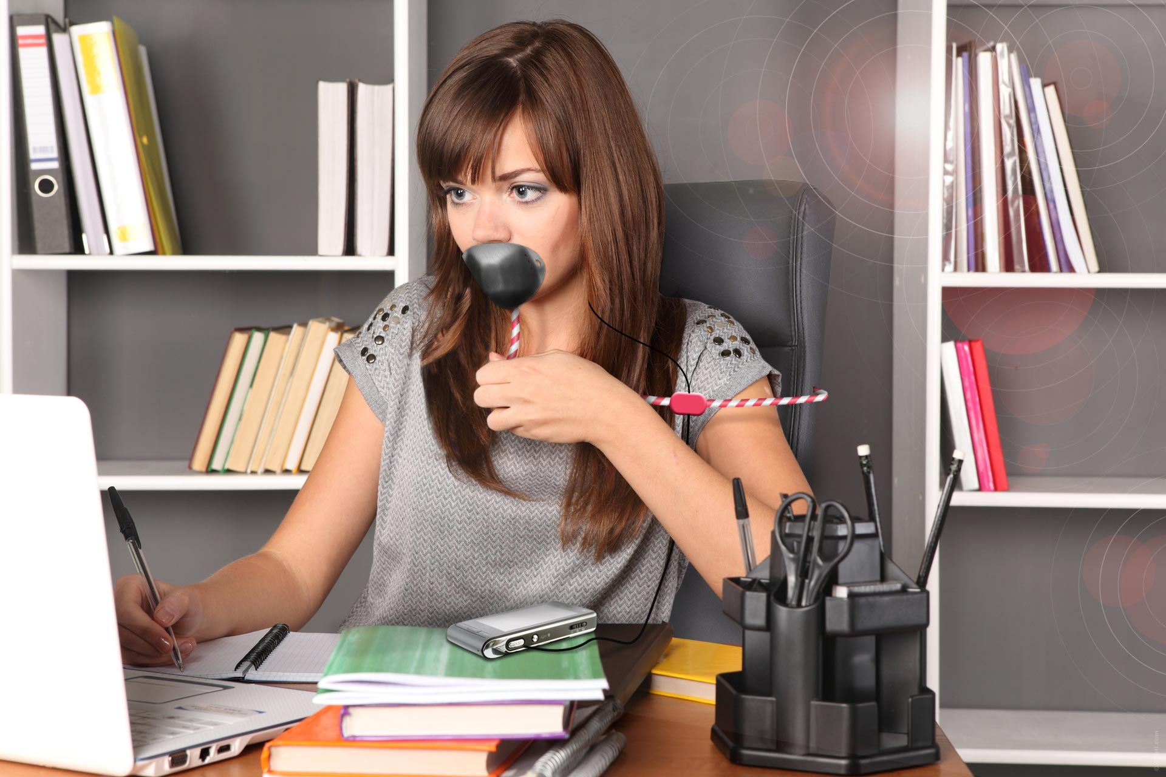
Everyday Situations
Quiet Work Environment
Voice recognition
Noise free
Lower speaking level
Discussion Privacy
Freedom desk / chair
Flexibility
move desk to desk with speaker device kit
B

Slide 19
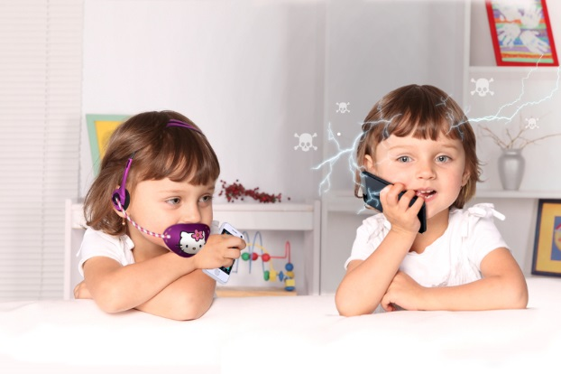
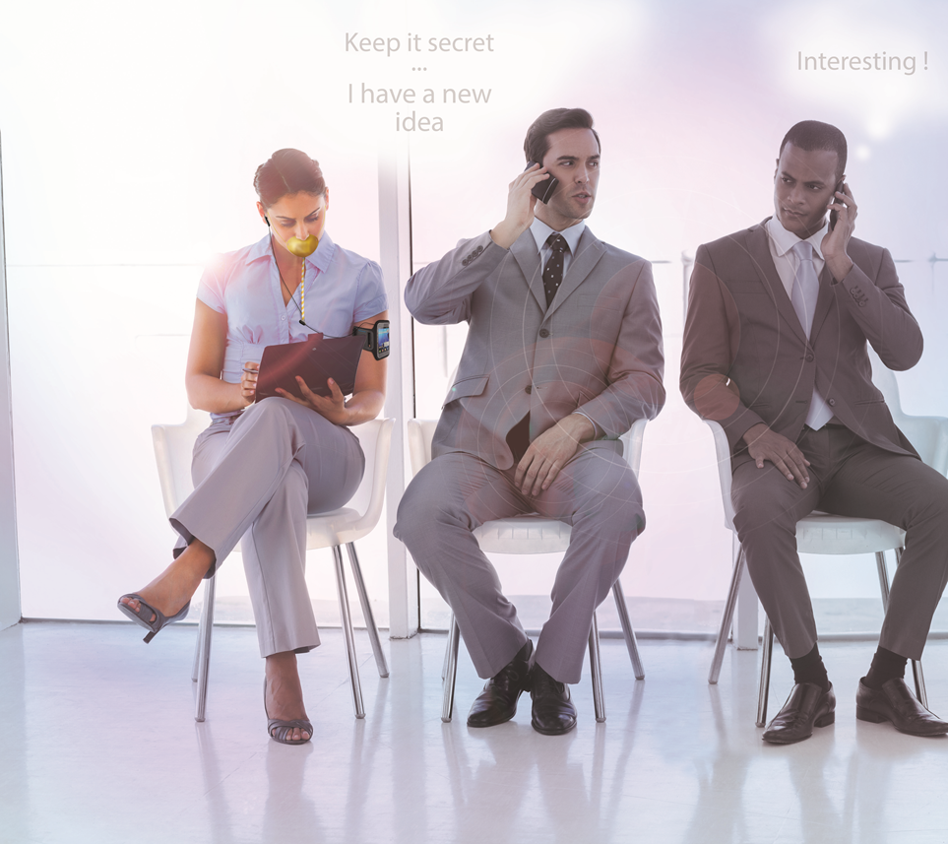
Everyday Situations
Silent speaker device with wireless

Slide 20
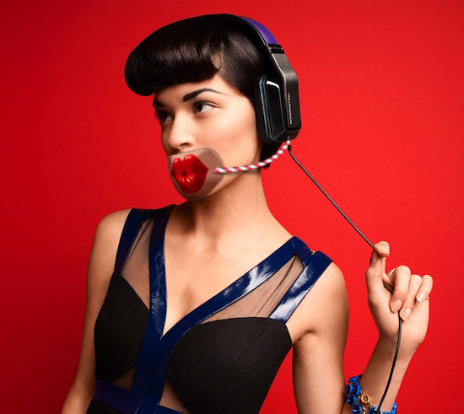
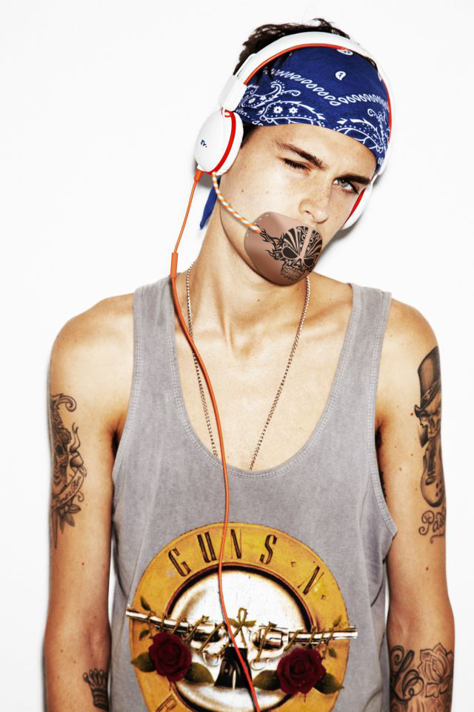
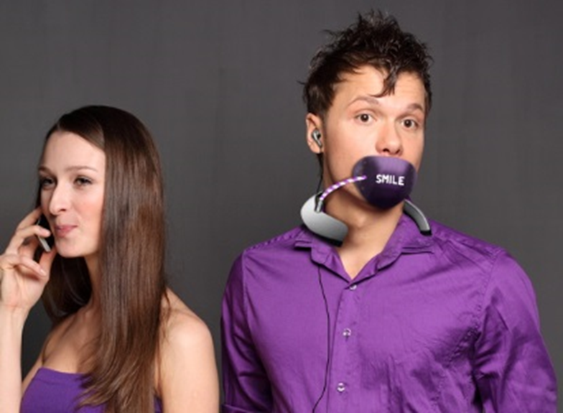
Everyday Situations
Silent speaker device with wireless

Slide 21
= Automatic switch from Music listening to phone call
= Voice recognition to initiate phone calls
= Speaker device movable from mouth to top of head
= Speaker device tailored design & easily changeable for hygiene / mood
Everyday Situations
Silent speaker device with wireless
microphone
Tube linking
Speaker device to
microphone

Slide 22
Everyday Situations
Voice Recognition
CHATBOT’s are not reliable and are not trusted by users
Need for confidentiality (risks of voice cloning via AI (artificial intelligence)
Need improved transfer of voice to the computer
Avoidance of echo’s (creating confusion for proper sound analysis)
Constant flow of sound in one direction
Better with low sound ( no need for shouting)
Breathing
Enunciating

Slide 23
S.W.O.T. Analysis
        Sound attenuation
        Comfort and speaking ability (reduced stress)
        Voice quality
        Hygiene and safety

Slide 24
S.W.O.T. Analysis
1 - Sound attenuation
At all frequencies through the mass and compliant sound barrier
Impervious barrier, weight (or mass) is important
Provided by foam at high frequencies, open cells are important for sound attenuation
Voice is directed to the sound receiver of the phone or computer through the transfer tube
2 - Comfort and Speaking ability
Privacy mask designed to cover the mouth while leaving the lips free to move when speaking
Ability to breathe through proper openings in the mask and through the end of transfer tube
Possibility of cushions to soften contact with skin
Hand held or affixed by straps or other means, light weight

Slide 25
S.W.O.T. Analysis
3- Voice Quality
No echoes or resonance inside the mask
No disturbance at the end of transfer tube
No outside noise, such as wind, traffic, etc.
Possibility of voice recognition
4 - Hygiene and safety
Washable mask
Disposable foam layer, protective cover (face tissues) and transfer tube
No VOC's , UV degradation, personalized items
Plastic with food quality
Flame resistance in public transport

Slide 26
Need Analysis
Ask 1: We Need a Prototype for consumer panel testing
Ask 2: We would like to license out the rights to this Intellectual Property

Slide 27
Questions?

